Slide 1

Gym management system

Slide 2
The Gym Management System is an online platform designed to digitize gym operations, providing secure and accessible digital receipts and automated notifications. It enhances both user and admin experiences by streamlining member management, billing, and notifications. Developed using HTML, CSS, JavaScript, and Firebase, it ensures safe, testable, and maintainable code.

Slide 3
Technologies:
Frontend: HTML, CSS, Java Script
Backend: Firebase
Domain: Sports

Slide 4
Project Modules:
Admin Module:
Login: Secure admin authentication.
Member Management: Add, update, or delete member information.
Billing: Create and manage bills, assign fee packages, and generate payment receipts.
Notifications: Set up monthly fee reminders and other notifications.
Reports: Export various reports for administrative purposes.
Supplement Store & Diet Details: Manage additional services like supplements and nutrition advice.

Slide 5
Member Module:
Login: Secure member authentication.
View Bills: Members can view their payment receipts and notifications.
Update Profile: Members can update their personal information.

Slide 6
User Module:
Login: Secure user authentication.
Search Records: Users can search and view relevant gym information

Slide 7
Features:
Digital Receipts: All receipts are stored digitally, eliminating the risk of loss.
Automated Notifications: Alerts for fees and other important information are sent automatically.
Modular Code: The code is written in a modular fashion, ensuring it is safe, testable,
maintainable, and portable.
GitHub Repository: Code is maintained publicly on GitHub with a comprehensive README file.

Slide 8
How It Works:
Admin Login and Management:
The admin logs in to the system using secure credentials.
The admin can manage member information, create bills, assign fee packages, and generate reports.
Notifications for payments and other important updates are set up by the admin.

Slide 9
Member Interaction:
Members log in to the system using their credentials.
They can view their payment receipts and any notifications sent by the admin.
Members can also update their personal information as needed.

Slide 10
User Access:
Users log in to access general gym information and search for specific records.
The system ensures that all users have the information they need in an organized and accessible manner.

Slide 11
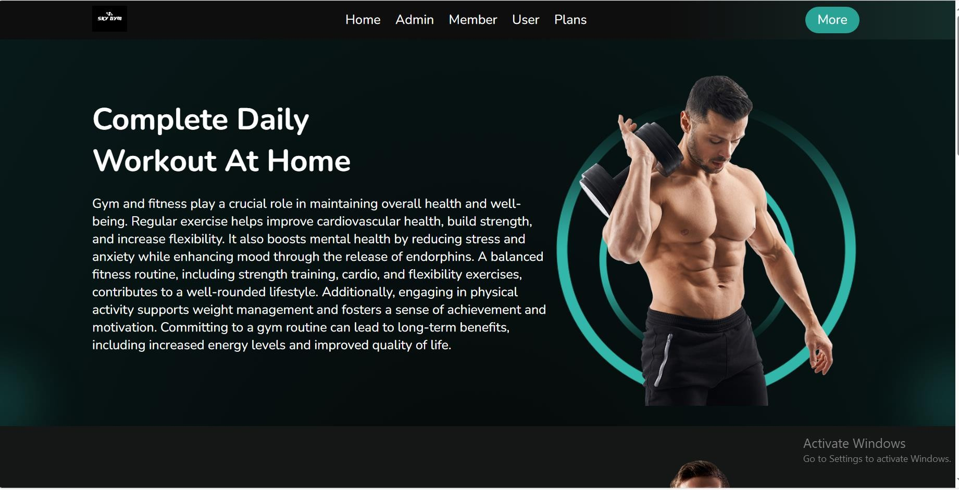
Website:

Slide 12
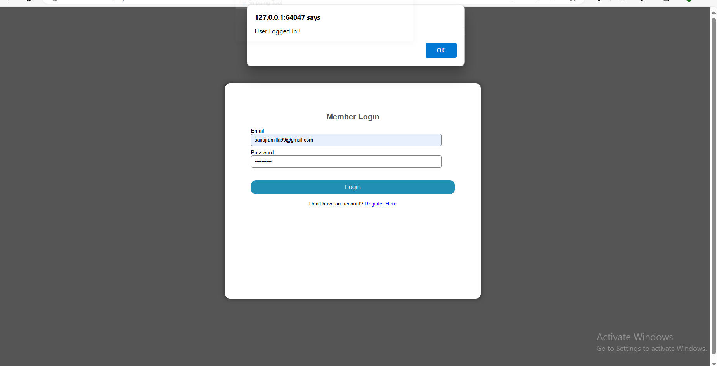
Login authentication:

Slide 13
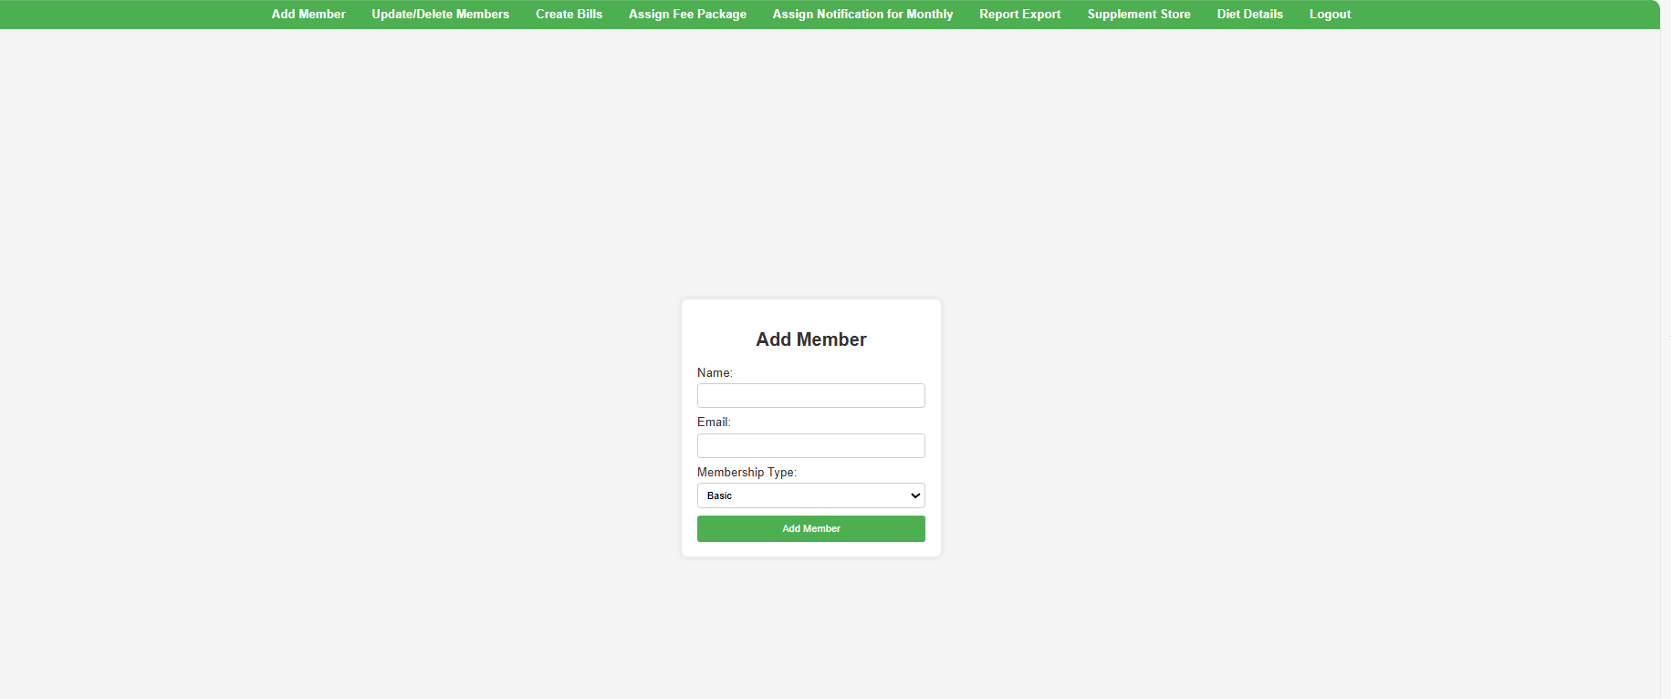
Admin login:

Slide 14
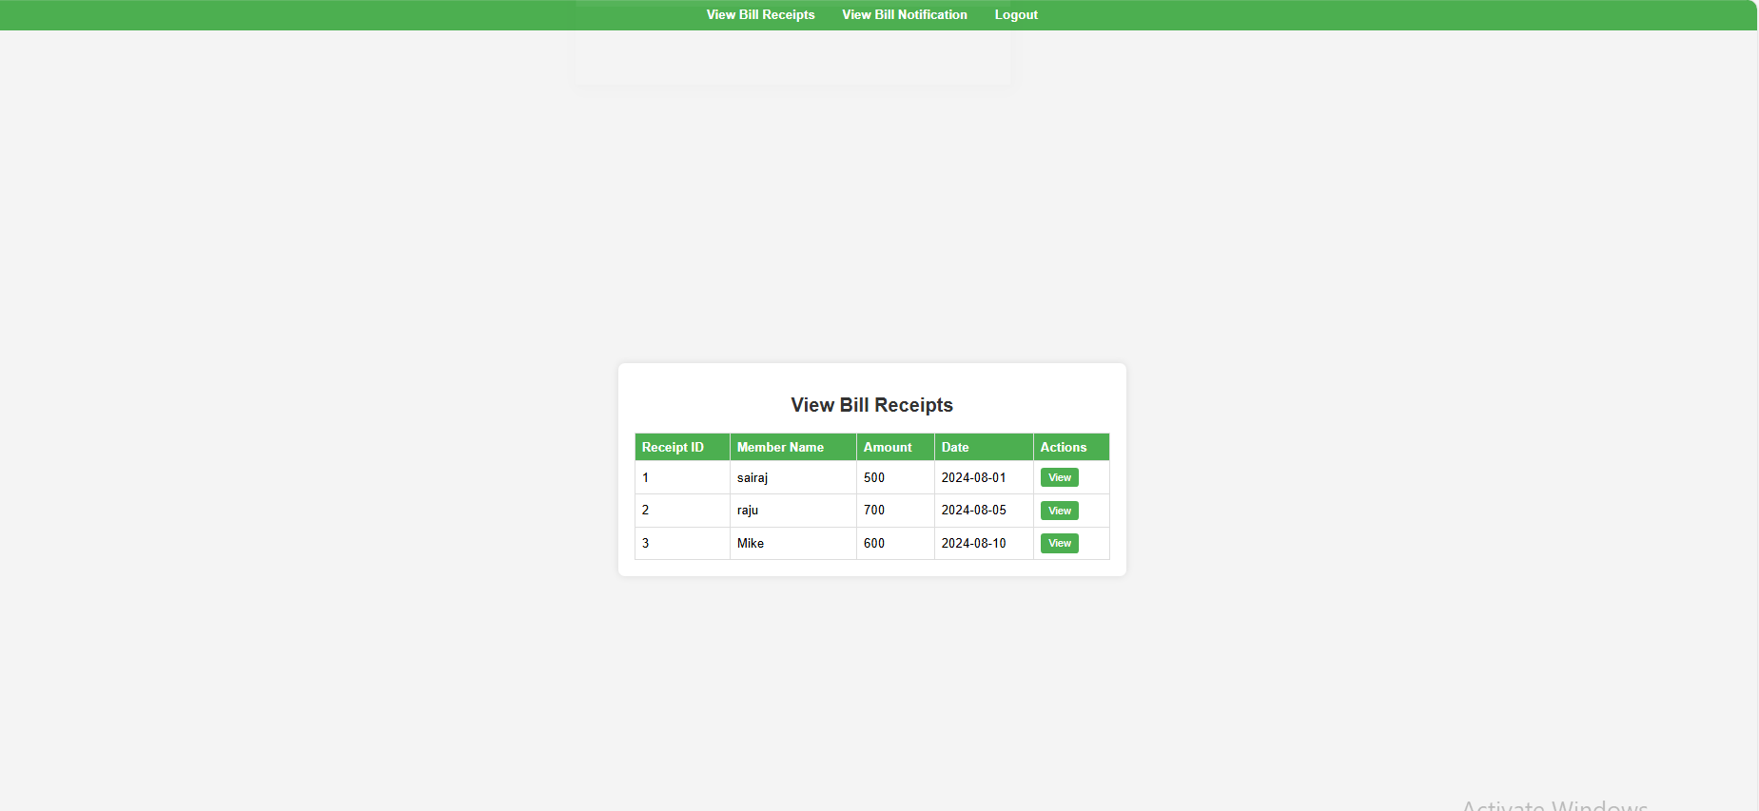
Member login:

Slide 15
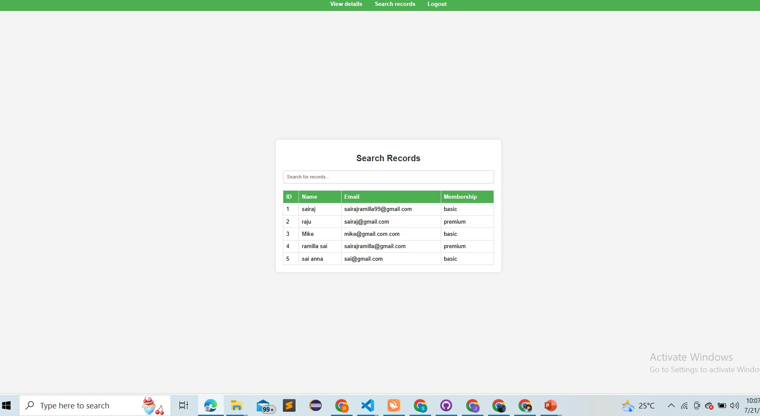
User login:

Slide 16
Thank you

